Slide 1

Seed Funding Pitch
Reactor Games LTD
Notes:
Ollie

Slide 2
Introduction
Reactor Games Ltd is a game-based learning company that specialises in the education of the future workforce in the concepts of the nuclear industry.
The aims of our company are to:
Increase understanding of the nuclear industry
Provide an opportunity for children to participate in a different type of learning
We have designed a card game that challenges players to build, commission, and decommission nuclear reactors and face real-world challenges that nuclear plant operators face.
Notes:
Ollie

Slide 3
Vision, Mission, and Values
Vision
To be the number one nuclear education business in the gamified learning industry
Mission
Provide a game-based learning experience to schoolchildren
Educate schoolchildren on the benefits and misconceptions of nuclear as part of the energy mix
Encourage talent into the nuclear industry
Values
Transparency – Open and honest with our team and other business stakeholders.
Curiosity – Always wanting to learn from our experiences to continuously improve
Commitment – Passionate about the nuclear industry and inspiring the next generation of talent.
Notes:
Chloe

Slide 4
Corporate Objectives & Measuring Success
We have three corporate objectives that are at the heart of our business.
These provide us with focus and are aligned to our Vision, Mission, and Values. Our Corporate Objectives are:
We will educate 1000 children in the nuclear fuel cycle
We will achieve an operating surplus of 15%
We will continuously improve and learn from experience
Criteria | Key Performance Indicator
Positive Customer Feedback Received | 80% of feedback received to be positive
Operating Surplus Margin | Achieve an operating surplus margin of 15%
Revenue | Achieve a revenue of at least £2,000
Employee Satisfaction | Average mood ladder rating of at least 7/10.
Quantity of Sponsorship Deals Signed | 5 sponsorship deals signed
Students Learning | 80% of students’ word association will see progress to positive associations from before and after
Positive Impact on Schools | 100 card games donated to schools 500 children educated through lessons delivered 17 lessons delivered
Notes:
Scott

Slide 5
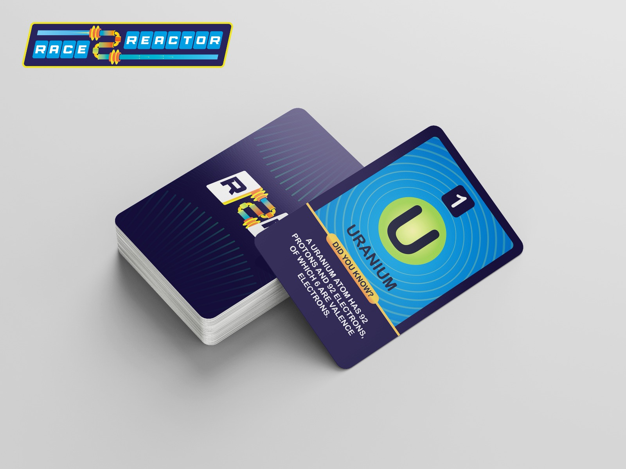
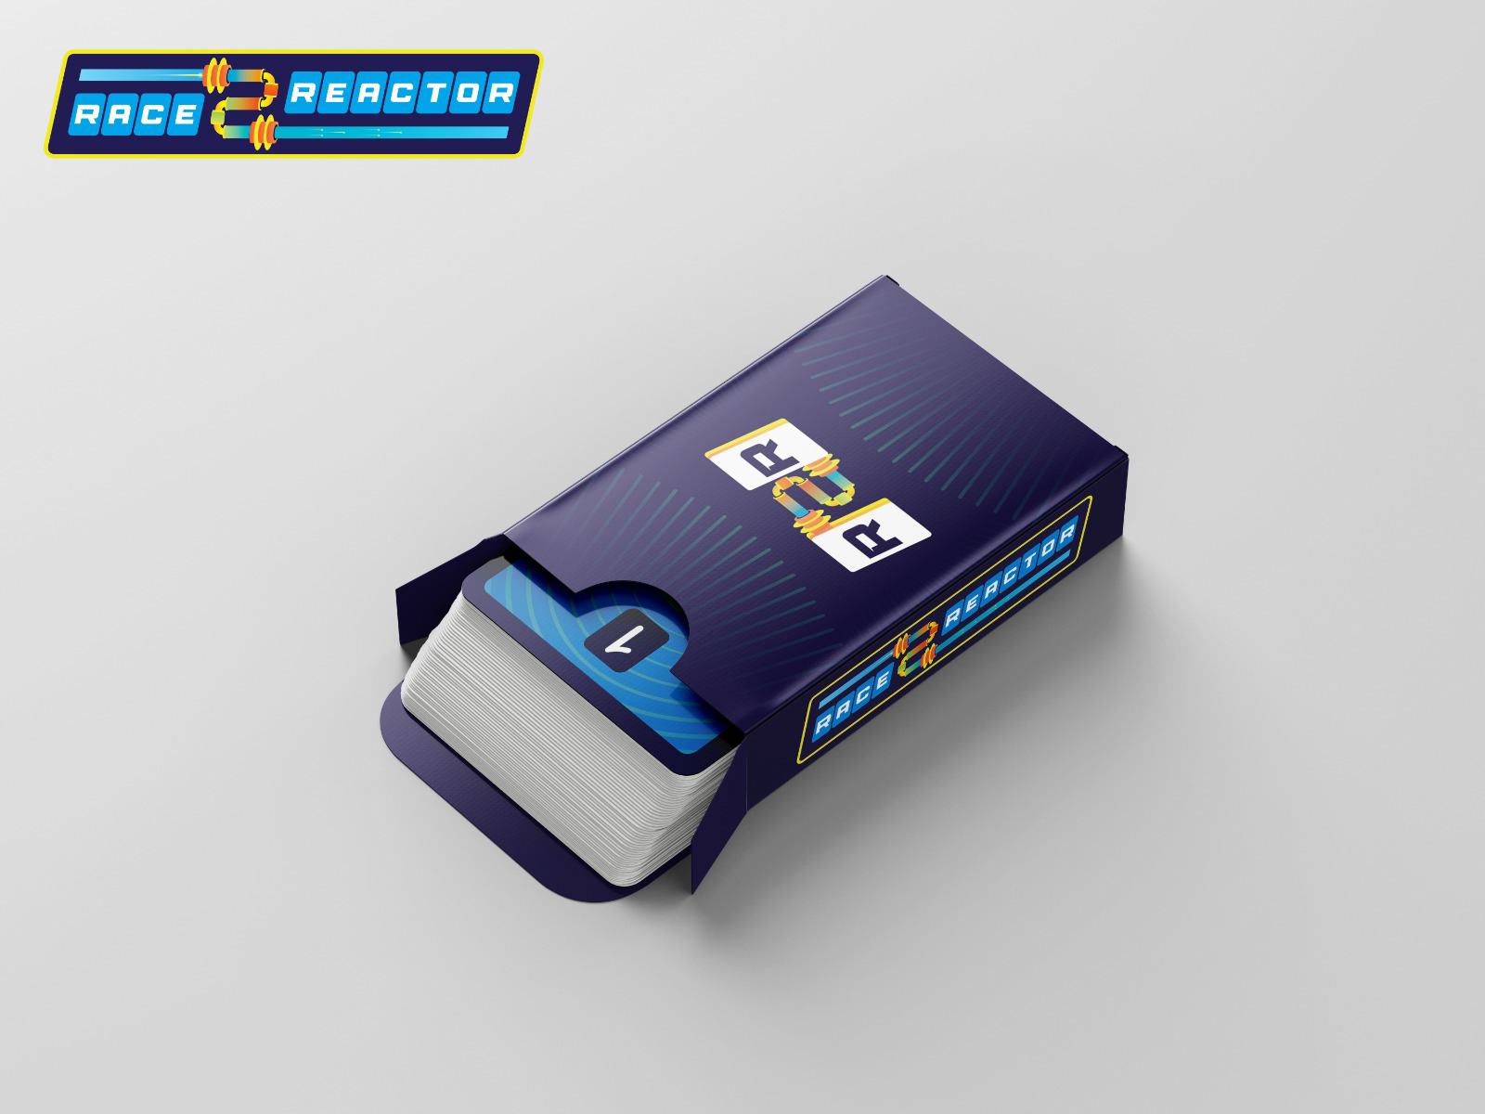
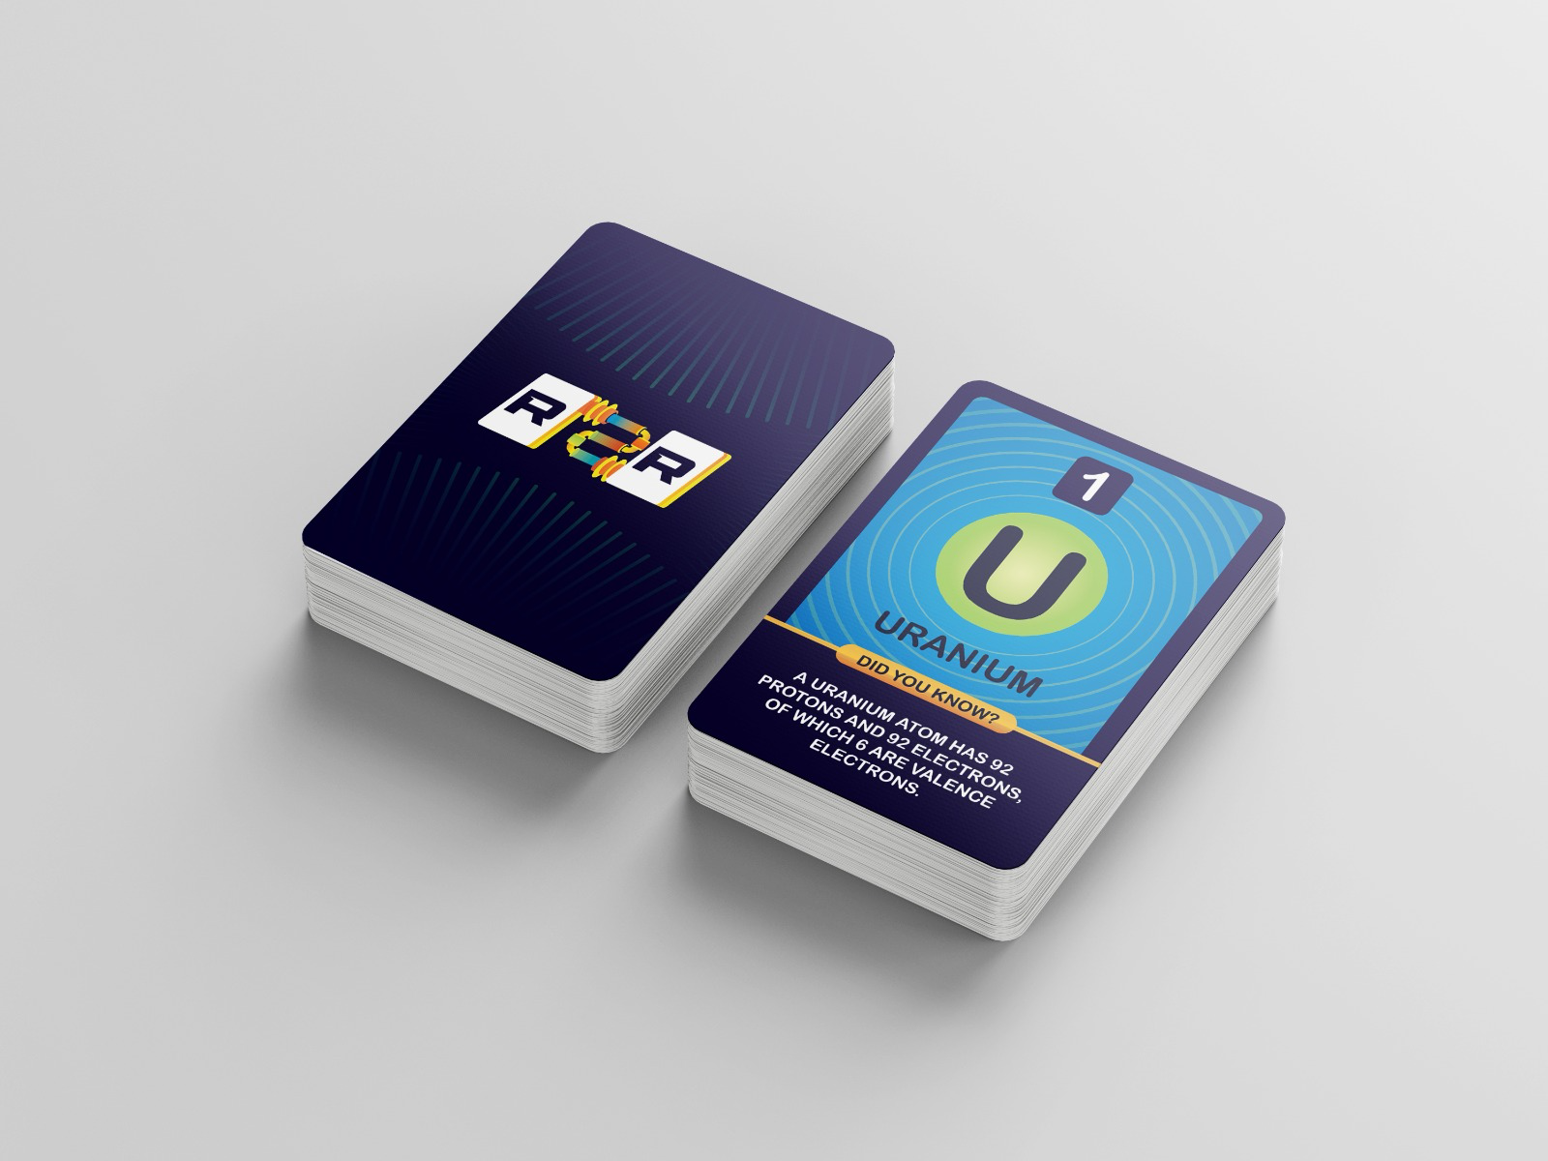
Our Product
Notes:
Jerin

Slide 6
The Idea
We have designed the card game to be easily understood by our target market (market testing pending).
A series of lessons have been planned and are being created for delivery within schools. They are educational, interesting, and complement the key nuclear learnings from our card game.
We will deliver these lessons to classes, providing an opportunity for students to play the game with their peers.
Eventually we hope that teachers can deliver these lessons without the support of the Reactor Games Team.
Notes:
Hannah

Slide 7
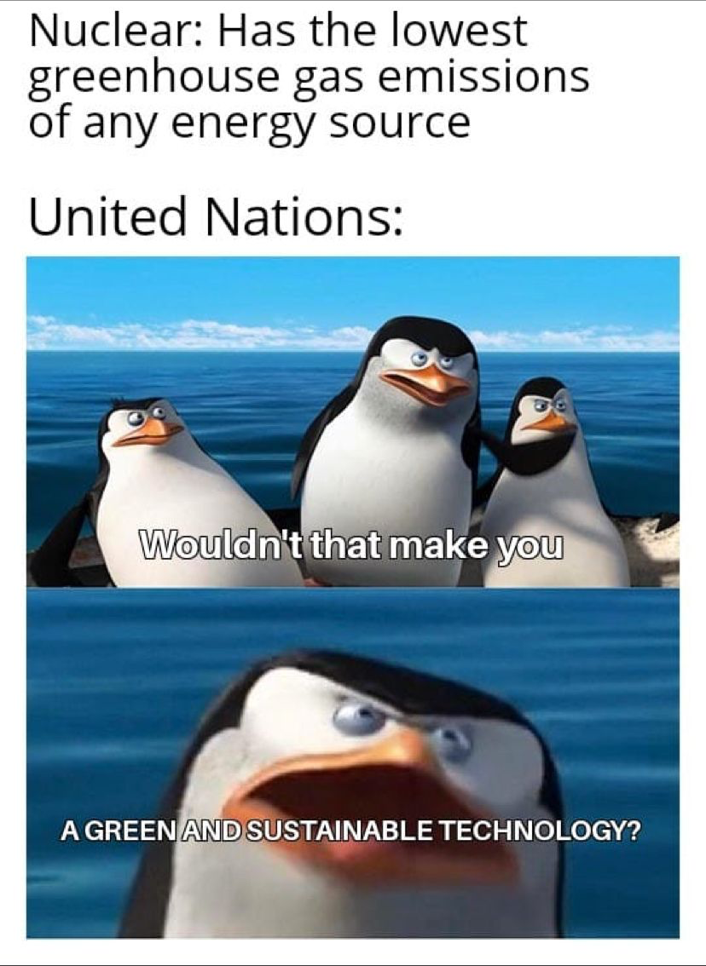

Social Media Engagement
We launched our social media in April as we wanted to establish an audience early in order to help us with the development of our game. Our primary social media platform is LinkedIn and as of last week we have over 325 followers on our company’s page!
The idea behind our social media is to provide the human element to our brand, and show our real passion for the nuclear industry.
There is scope to approach potential sponsoring organisations of our game through the followers of our page.
Notes:
Hannah

Slide 8
Finances
There are two parts to funding Reactor Games Ltd; Seed Funding & Sponsorship Funding
To achieve our corporate objectives, we need to raise £2000 through Seed Funding, explained on the next slide, and £1,882.37 through Sponsorship Funding
1 Game & 1/6 of a Lesson (6 games per lesson) MOQ 100
Description | Qty Per Unit | Cost (£ inc. VAT)
Deck of 234 cards in a custom rigid box | 1 | £ 21.85
Rulebook | 1 | £ 1.35
Shipping | 1 | £ 2.37
Lesson | 0.17 | £ 8.50
Total Cost |  | £ 34.07
15% Markup |  | £ 39.18
Notes:
Daniel

Slide 9
Finances- Seed Funding
Item | Cost (£) | Qty | Total Cost (£ inc. VAT)
Stock & Lessons | £ 1,770.16 | 1 | £ 1,770.16
Company Registration | £ 12.00 | 1 | £ 12.00
Website Hosting & E-mail | £ 3.99 | 14 | £ 55.86
Domain Name | £ 5.99 | 2 | £ 11.98
Insurance | £ 150.00 | 1 | £ 150.00
Total |  |  | £ 2,000.00
Notes:
Daniel

Slide 10







Sponsorship
We have contacted 10 sponsors from across the nuclear industry, including:
Notes:
Scott

Slide 11
Next Steps
Secure seed funding
Complete the design of the game
Secure sponsorship
Complete our lesson delivery plan
Engage with teachers
Conduct further market testing
Place an order with our chosen manufacturer
Notes:
Adnan

